Slide 1



personal finance assistant
Let’s start!

Slide 2

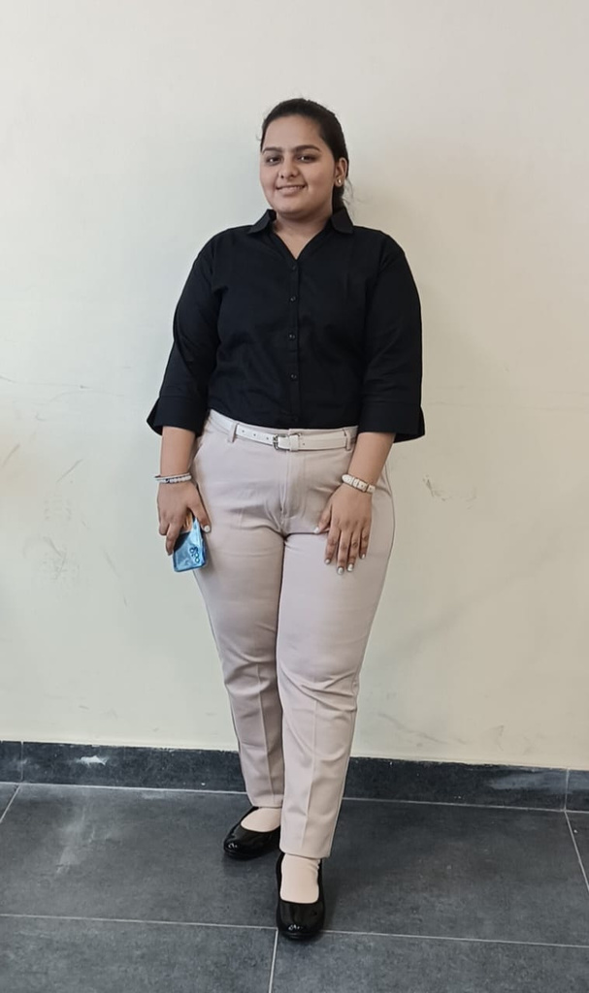



Meet the team
innoventures
isha garg
somalika
kashish

Slide 3



content
1
5
Problem Statement
Uniqueness
2
6
Introduction
Working
3
7
Need
Approach
4
8
Technology used
Demo

Slide 4
PROBLEM STATEMENT!
Develop a personalized financial assistant powered by Al that helps consumers manage their finances, make payments, and suggest budget advice and optimal payment options, including flexible payment choices
Let’s begin!

Slide 5
INTRODUCTION OF THE PROJECT
Developed a cutting-edge Personal Finance Assistant that aims to simplify these tasks, empower users to make informed financial decisions, and ultimately enhance their financial well-being.
Let’s begin!

Slide 6
need for this project
Financial Literacy Crisis:
->Many individuals lack basic financial knowledge despite technological advances.
->Studies reveal a global deficiency in financial literacy, resulting in poor financial decisions and increased vulnerability to financial crises.
Empowering Individuals:
->Providing tools and knowledge for informed financial decision-making is essential.
->The Personal Finance Assistant aims to bridge the financial literacy gap with accessible and user-friendly financial management solutions.
Impact:
->Promoting financial literacy and offering practical financial management tools can empower individuals.
->This empowerment helps individuals achieve their financial goals and secure their future.

Slide 7
APPROACH
1. Planning and Requirements Gathering
Frontend : HTML,CSS,JAVASCRIPT
BACKEND : Node.js
¡Database: MongoDB
Measures: Plan for data encryption, secure authentication, and protection against common vulnerabilities.

Slide 8
APPROACH
2. DesignUser Interface Design:
Create wireframes and mockups of the user interface using tools like HTML.
User Experience Design: Plan user flows to ensure seamless navigation through the website, from logging in to receiving budget advice.

Slide 9
APPROACH
3. DevelopmentSet Up the Environment:
User Authentication: Implement login and signup functionality .
Expense Management: Create APIs to add, delete, and retrieve expenses.
Expense Calculation: Develop logic to calculate total expenses and generate detailed breakdowns.
Budget Advice: Implement algorithms to analyze spending patterns and provide personalized budget advice using lm studio and AI algorithm.
¡
Frontend Development :
User Interface: Develop the UI components based on the design mockups.
API Integration: Connect frontend components with backend APIs for data exchange.Responsive Design: Ensure the application is responsive and works well on various devices.

Slide 10
APPROACH
4. Testing
Unit Testing:
Write tests for individual components and functions to ensure they work as expected.
Integration Testing: Test the interaction between different modules and APIs.
User Acceptance Testing (UAT): Have real users test the application to provide feedback and identify any issues.
Security Testing: Perform security assessments to identify and fix vulnerabilities.

Slide 11
APPROACH
5. Deployment
Choose Hosting Platform:
Select a hosting provider such as AWS, Google Cloud.
Set Up CD Pipeline: Automate deployment processes to ensure smooth and consistent updates.
Monitor and Maintain: Continuously monitor the application for performance and security issues, and perform regular updates and maintenance.

Slide 12
APPROACH
6. Documentation
User Documentation:
Create guides and help resources for users to understand how to use the website.
Developer Documentation: Document the codebase, APIs, and development processes for future maintenance and development.

Slide 13

uniqueness of the project
¡Personalized Budget Advice:Offers tailored budget recommendations based on individual spending patterns, helping users make informed financial decisions.
¡Comprehensive Expense Tracking:Supports detailed categorization and custom categories, providing a complete picture of user finances.
¡Real-Time Expense Calculation:Calculates total expenses instantly as data is entered, keeping users aware of their spending habits.
¡User-Friendly Interface:Intuitive, responsive design ensures accessibility across devices, making financial management easy for all users.
¡Advanced Security:Utilizes robust encryption and secure authentication protocols, ensuring user data is protected.
¡AI-Driven Insights:Uses machine learning to offer predictive analysis and advanced insights into future spending patterns.

Slide 14


Slide 15
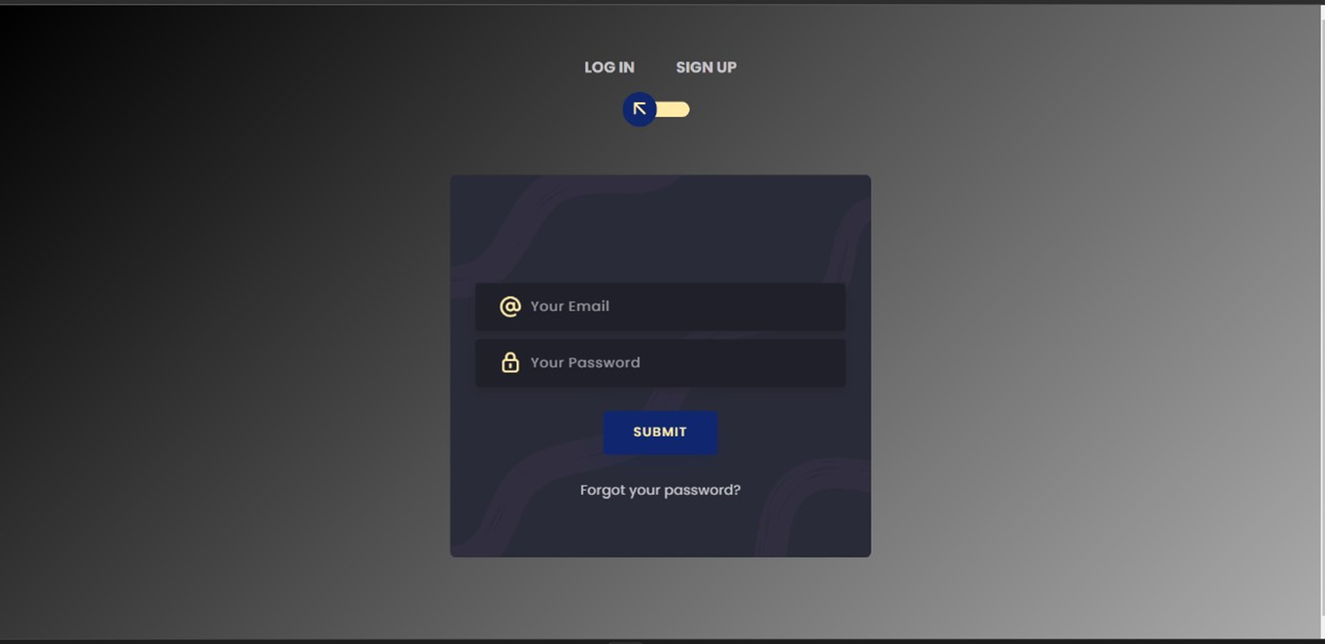

Slide 16
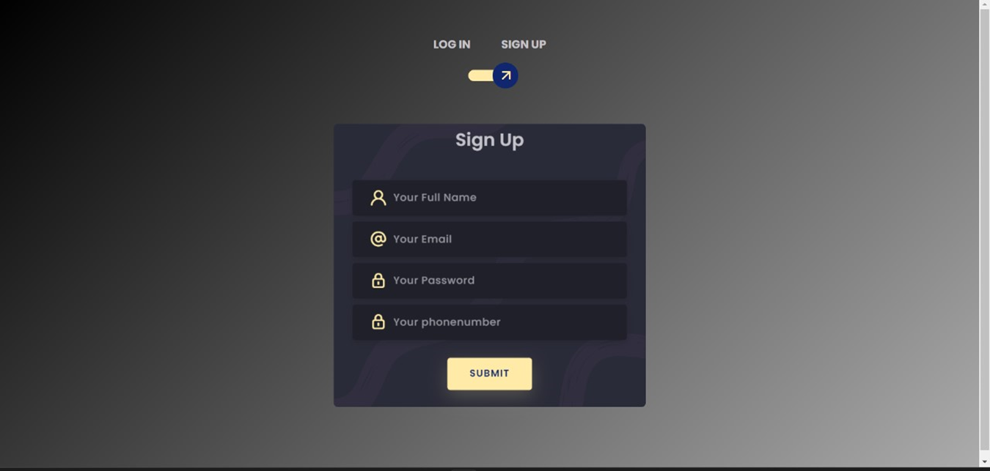

Slide 17
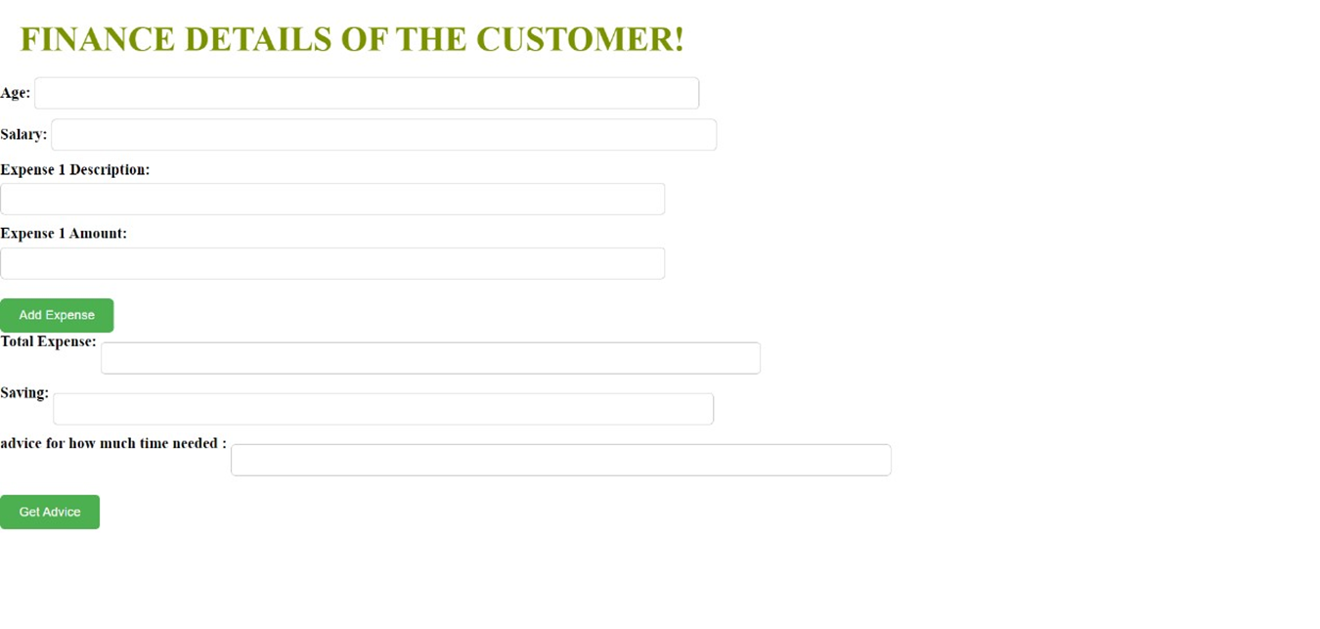

Slide 18
future technology
Our vision
Our vision for Finance Assistant is to empower users with an intuitive, personalized finance management tool that enhances financial health.
We aim to:
Empower Users: Provide actionable insights for informed financial decisions.
Personalize Experience: Offer tailored advice and customizable expense categories.
Ensure User-Friendliness: Create an accessible, easy-to-use interface.
Boost Engagement: Use gamification and community features to motivate users.
Proactive Management: Utilize AI for expense forecasting and proactive advice.
Prioritize Security: Maintain robust data security and user trust.
Integrate and Automate: Automate data entry through financial institution integration.
Holistic Financial Health: Offer comprehensive financial health views and recommendations.
Our long-term goals include increasing financial literacy, expanding globally, and continuously improving to meet user needs.

Slide 19
Thank
you!
Don’t hesitate to contact us
www.FINBRAIN.com

